Slide 1
Neutrina, co nowego w teorii?
Marek Zrałek
Instytut Fizyki
Uniwersytetu Śląskiego

Slide 2
Streszczenie
Po odkryciu i rozwikłaniu problemu oscylacji, fizyka neutrin stała się w ostatnich latach jednym
z głównych elementów fizyki cząstek elementarnych. Tak jak w przeszłości, również obecnie, odkrycia związane z neutrinami przynoszą przełomowe informacje o oddziaływaniach elementarnych, astrofizyce i kosmologii.
Wykład będzie omawiać różne teoretyczne pomysły, o których usłyszeliśmy w ostatnim czasie. Tak więc będzie mowa o problemie natury neutrin, o masie
i zapachu, o neutrinach Mössbauera, o anomalii GSI
i wielu innych nowościach.

Slide 3
News
in the theory
of neutrino physics
Wrocław
9. 11. 2009
Marek Zrałek,
Uniwersytet Śląski

Slide 4
Outline
Introduction
Neutrinos in the Standard Model (SM)
Experimental facts
Neutrinos in the SM with small ν mass
Neutrino mass beyond the SM
Questions
Conclusions and perspectives

Slide 5
1) INTRODUCTION – What is behind us?
Neurinos always give a new and unexpected informations about elementary interactions
In 1930, Pauli, remedy for the energy crisis observed in the
beta decay,
In 1934, Fermi, neutrinos were used to construct the first
theory of week interaction – Fermi theory for beta decay,
Majorana in 1937, particles which are the same are their
antiparticles can exist – Majorana particles,
Lee & Yang (1956), Wu (1957) - P and C symmetries are
broken in Nature,

Slide 6
Gargamelle (1973), neutral currents exist – first indication
about Z boson,
(Years 60-70), neutrinos are parts of the leptons doublets –
Glashow, Weinberg & Salam of the unified model of
electromagnetic and week interaction was created – the
Model Standard,
In 1987 neutrinos from the supernova SN87A were observed
– the theory of supernova explosion was confirmed,
In LEP, 1989, in Z decay - first observation that only three
generation of quarks and leptons exist in Nature,
In

Slide 7

1956 | 3
7 | 8
8 | 2
9 | 2
1960 | 9
1 | 4
2 | 6
3 | 20
4 | 18
5 | 12
6 | 9
7 | 9
8 | 29
9 | 70
1970 | 91
1 | 81
2 | 92
3 | 132
4 | 196
5 | 245
6 | 311
7 | 298
8 | 367
9 | 311
1980 | 432
1 | 412
2 | 318
3 | 227
4 | 375
5 | 344
6 | 541
7 | 598
8 | 498
9 | 449
1990 | 481
1 | 536
2 | 693
3 | 540
4 | 540
5 | 563
6 | 591
7 | 642
8 | 876
9 | 1006
2000 | 1195
1 | 1155
2 | 1119
3 | 1168
4 | 1001
5 | 1031
6 | 1094
7 | 829
8 | 613
Between 1998 and 2003 – solar neutrino
problem was resolved – first independent proof
that Bethe model of energy creation in stars –
hydrogen nucleosynthesis is correct
Superkamiokande, in 1998, first real
confirmation that atmospheric neutrinos
oscillate – neutrinos are massive particles –
the Standard Model has to be extended
How to extend
the Standard Model????
JJaak

Slide 8
Neutrinos
in
the Standard Model

Slide 9
2) Neutrinos in the Standard Model
1) There is no RH neutrinos,
2) There is only one Higgs doublet of SU(2)_{L},
3) Theory is renormalizable,
But
vanishing of neutrino mass is not guaranteed by any fundamental symmetry
As a consequense:
Neutrinos
are
massless

Slide 10
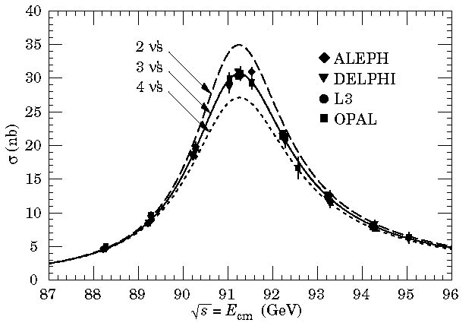
F.Reines & C. Cowan (1956) - ν_{e}
M. Schwartz, L. Lederman, J. Steinberger (1962) – ν_{μ}
DONAT Collaboration in Fermilab (2000) - ν_{μ} .
There are three flavour neutrinos:
Distinguished by three flavour numbers
From Z₀ decay- LEP- there are only three flavour neutrinos

Slide 11


Neutrino interaction in the Standard Model
From 1998 we know that neutrinos are massive, what kinds of mass term we have to add to the SM??
Dirac mass?
L
or Majorana mass??
R

Slide 12
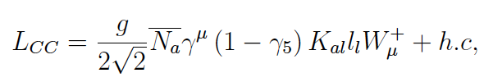


So in the frame of the new Standard Model
For three
neutrinos:
(νSM)
W obecnie prowadzonych eksperymentach
In the present experiments:
Practical Dirac – Majorana Confusion Theorem
Differences in all observables for the Dirac and Majorana neutrinos smoothly vanish for m_{ν} 0

Slide 13
What we know
from
experiments??

Slide 14
3) Present experimental data
1) Very preciselly we know masses of charged leptons
2) Neutrino masses we know indirectly
From tritium beta decay
From oscillation experiments

Slide 15
From oscillation experiments:

Slide 16
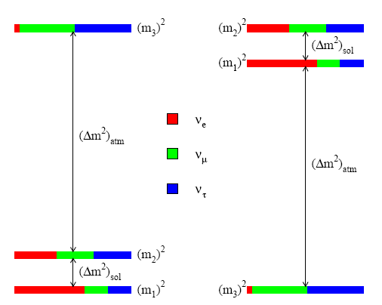
We do not know!!
A)The neutrino mass scheme:
Mass hierarchy
Inverse mass hierarchy
Degenerate
B) Neutrino nature - Dirac or Majorana
C) Are the CP symmetry violated or no, phases
Dirac - δ,
Majorana - α₁, α₂
D) Is mixing angle θ₁₃ different from zero

Slide 17
Neutrinos
in the
New Standard Model
(νSM)

Slide 18
4) Neutrinos in the SM with massive
neutrino
Durinng last two years two important properties of neutrino oscillation were discused:
Mössbauer Neutrinos,
Anomaly observed in the GSI
W.M.Visscher, 1959
W.P. Kells, J.P. Schiffer,1983
R.S. Raghavan,2006
MÖSSBAUER NEUTRINOS

Slide 19
For Tritium embedded into a cristal

Slide 20

Even if we assume that various brodening effects degrade this value :
W. Potzel, 2006,
R.S. Raghavan, 2006,
but W. Potzel in Ustron 2009 – probably observation of the effect in ³H - ³He will be unsuccessful
Energy difference for two relativistic neutrinos with energy E
Atmospheric neutrinos
Then for:
Neutrinos
should not oscillate
We obtain:

Slide 21
Do Mössbauer neutrinos oscillate ???
E.K.Akhmedov, J. Kopp, M. Lindner, 2008
If:
No oscillation
But if:
Neutrinos oscillate
Why is possible to have such big Δp?? For particles on mass shell:
In bound states, energy and momentum are not connected by the on mass shell relation (e.g. eigenstate of harmonic oscillator has definite energy but not momentum)

Slide 22
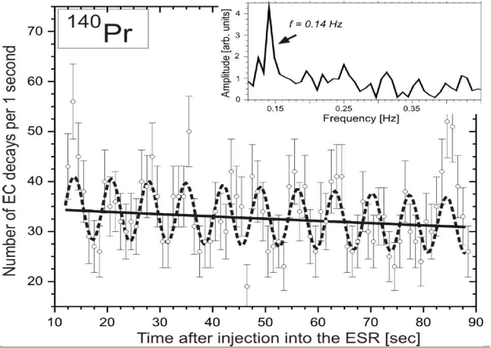
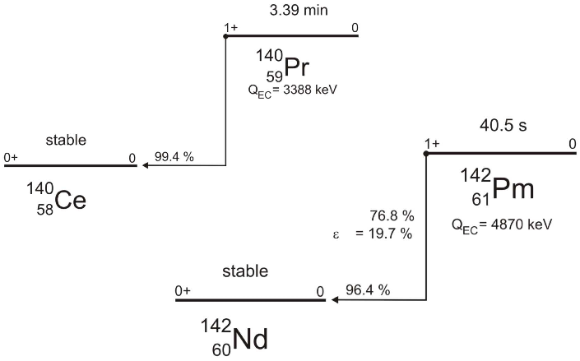
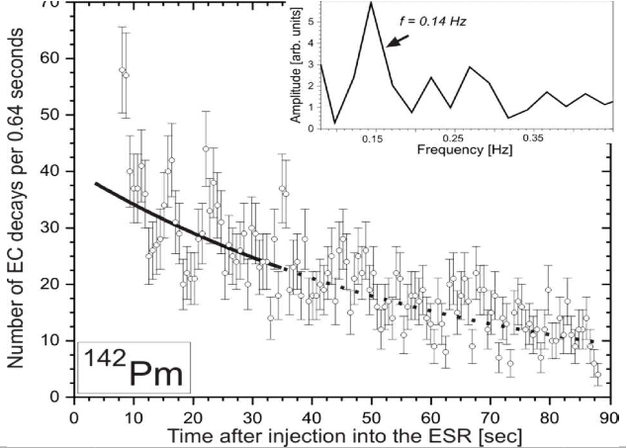

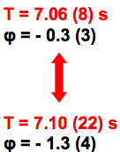
GSI, ArXiv:0801.2079
Giunti; Ivanov, Reda and Kienle; Lipkin; Peshkin; Burkardt, Lowe, Stephenson; Ivanov, Kryshen, Pitschmann, Kiele; Giunti; Lipkin….
There are attempts to explain these observations as neutrino oscillation
Notes:
Pr –prazeodym, Ce – cer, Pm – promet, Nd - neodym
22

Slide 23
Litvinov et al. (GSI), Phys. Lett. B664, 163 (2008)
N. Ivanov at. al., arXiv:0801.2121,
H. J. Lipkin, arXiv: 0801.1465, arXiv:0805.0435 (The GSI method for studying neutrino mass difference – For Pedestrians),
H. Kleinert, P. Kienle, arXiv:0803.2938.
Neutrino oscillation with the period:
C.Giunti, arXiv:0801.4639,
H Kienert at al., arXiv:0808.2389,
M.Peshkin, arXiv:0804.4891, arXiv:0811.1765,
No oscillation

Slide 24
Probability that measurement
of any observable A gives one of the eigenvalue
a₁, a₂, .... a_{N} Δ :
There is no interference

Slide 25
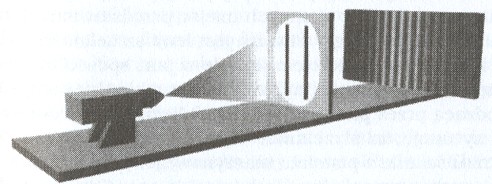
In the two slits experiments:

Slide 26
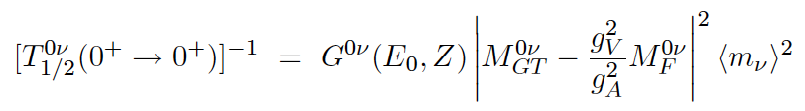
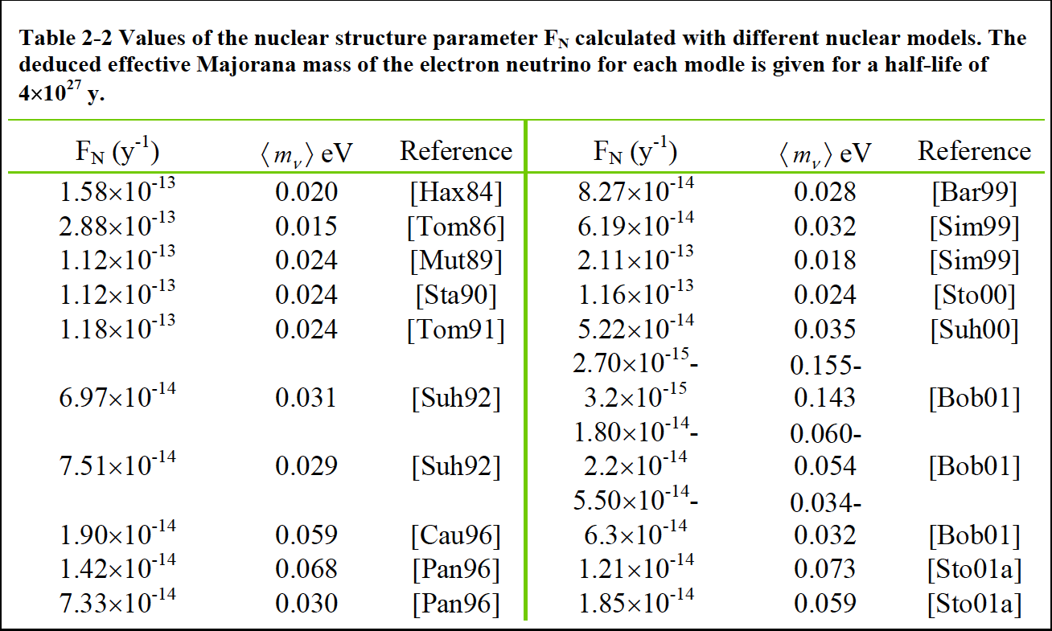
Neutrinoless double beta decay
Even-even nuclei, candidate for (ββ)_{0ν} decay:
Decay half- life:
Majorana Coll.,
nucl-ex/0311013
For the foreseeable future it will be impossible to calculate the NME direcly from QCD

Slide 27
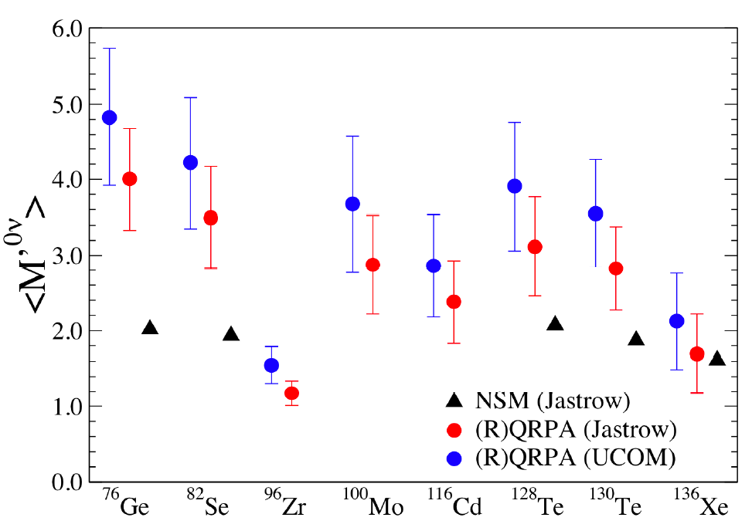
In the past years we have seen a significant improvement in the calculation of the NME
QRPA(Quasi-Particle-Random-Phase-Approximation)
ShM(Shell Modell)
P.Vogel,
arXiv:0807.2457

Slide 28
Neutrinos
beyond
the Standard Model

Slide 29
5) Neutrinos beyond the SM
MiniBOONE anomaly
Problem of neutrino mass and mixing
Neutrino oscillation beyond the SM
Leptogenesis

Slide 30
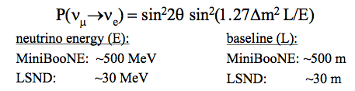
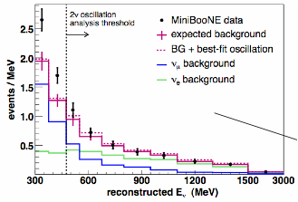
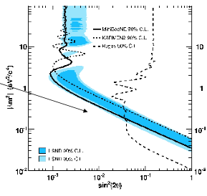
MiniBooNE
Notes:
Pierwsza praca w 2007 nie potwierdziło LSND nie widać oscylacji e neutrino elektronowe

Slide 31
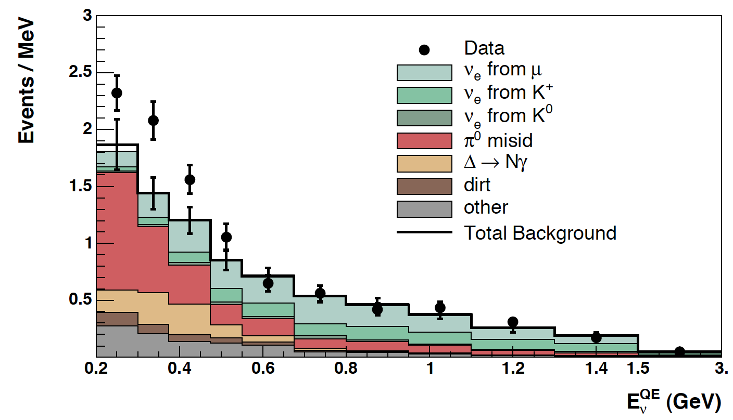
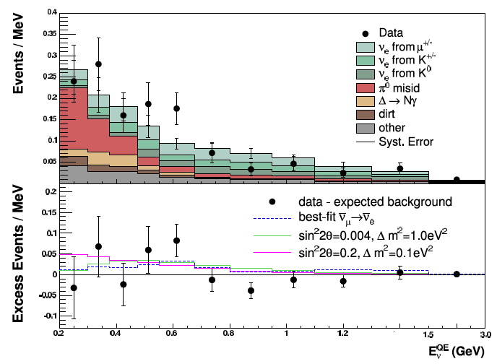
MiniBooNe coll.
arXiv:0812.2243
Sizable excess (128.8 ± 43.4) at low energy (200-475 MeV) for
transition, is observed.
MiniBooNE coll. arXiv:0904.1958
No significant excess of events has been observed for
oscillation at law (200-475 MeV ) and at high energy (475 -1250 MeV) regions.
In the same channel excess was observed by LSND

Slide 32
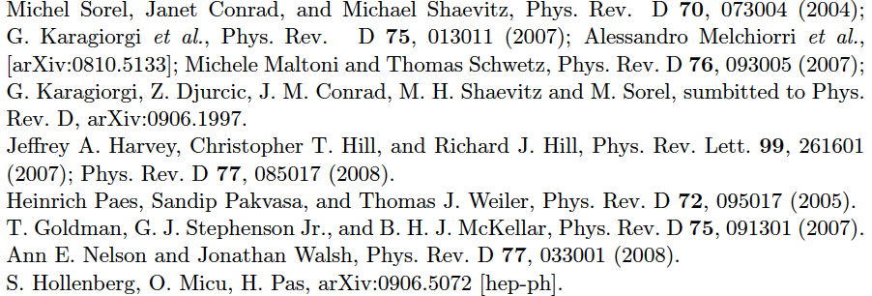
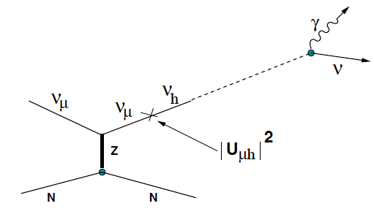
There are a lot of papers which try to explain the electron neutrino excess:
S.N. Ganienko,
arXiv:0902.3802
Extra – dimensions,
Sterile neutrinos,
CPT violating
interaction,
Neutrino –antineutrino
oscillation
Is there anomalous difference between neutrino and antineutrino properties ?? - result are inconclusive

Slide 33
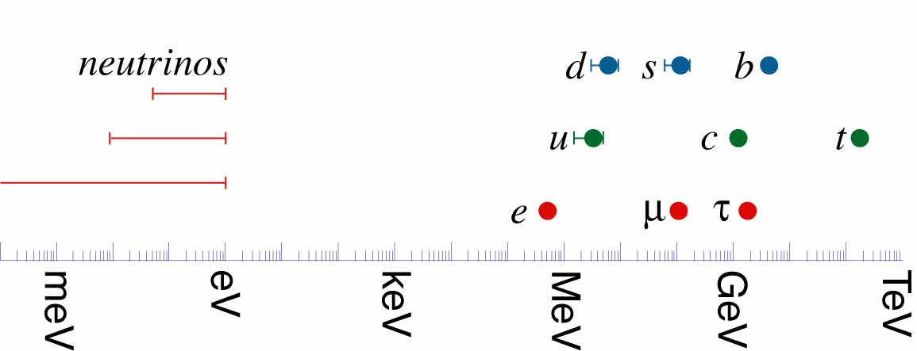
Problem of Mass and Mixing
Why neutrino masses are so small,
much smaller then charged leptons
and quarks masses
x 10⁶
10⁶
Why there two large mixing angles
for leptons which contrasts sharply
with the smallnest of the quark
mixing angles.
In the present Higgs mechanism

Slide 34
Why neutrino masses are very small, answer depends on neutrino nature
Dirac neutrinos ,
or
(II) Majorana neutrinos
(I) Neutrina Diraca
Righ handed neutrino fields have to be added
Resolutions: EXTRA DIMENSIONS

Slide 35
(II) Neutrina Majorany
See-saw mechanism
Higgs triplet Δ:
(See-saw II type)
Directly testable at LHC
Two Higgs doublet H:
R fermion singlet:
(Type I see-saw)
R₃ fermion triplet:
(Type III see-saw)

Slide 36
There is balance between
“naturalness” and
“testability”
Hierarchy problem scale ≈ 1TeV
GUT scale ≈ 10¹⁶ GeV
Planck skale ≈ 10¹⁹ GeV
Problem of neutrino mass is connected with their mixing
Tri-bimaximal (TB) mixing pattern

Slide 37
If then TB is satisfied
and would demand explanation.
If are closed to their current 2σ bounds, then TB mixing would only be realized approximately
If TB is realized –
signal of underlying family symmetry
Then from spectral theorem neutrion mass matrix can be decomposed

Slide 38
Where m_{i} are the neutrino masses,
and Φ_{i} - appropriate eigenvectors, so
Large numbers of different flavour symmetry groups
continuous: SO(3),SU(3),….
and discrete: Z, S, A,…

Slide 39
Non-standard neutrino intraction and Neutrino Oscillations

Slide 40
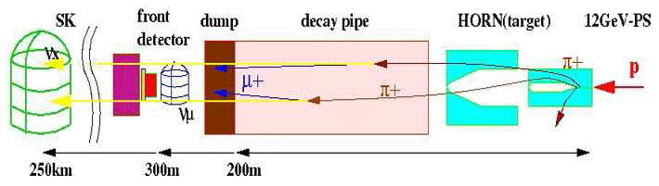
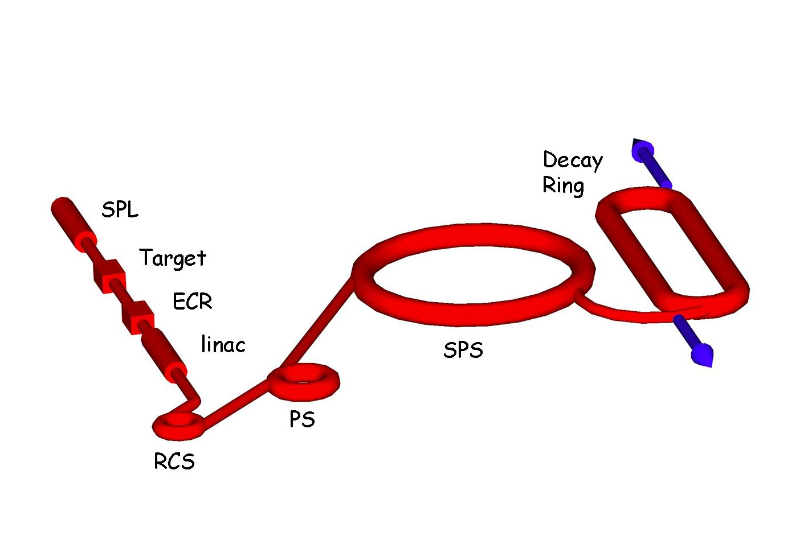
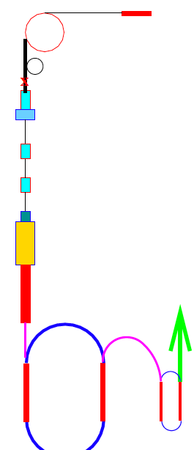

Different processes for neutrino production
Neutrino superbeams,
Off axis neutrino beams
Beta beams
Neutrino factories

Slide 41
Processes for neutrino detection

Slide 42
For production and detection processes - complex current
Relativistic (anti)neutrinos are produced in pure Quantum Mechanical flavour state
Neutrinos always with positive helicity
Antineutrinos always with positive helicity
Z. Maki, M. Nakagawa, S. Sakata, Prog.Theor.Phys. 28(1962)870

Slide 43
Neutrino propagation in the vacuum or in a matter –
- neutral current
No spin flip
P
D
No spin flip

Slide 44
Oscillation rate of neutrinos in a detector is described by the factorized formula
P
D
Number of the β
neutrinos with
energy E, which
reach detector
in a unit time
Density of the α initial neutrinos
Probability of theα to β
neutrino
conversion
Detection cross
section of
β neutrinos
Number
of active
scattering
centres
in a detector
Oscillation rate is the same for Dirac and Majorana neutrinos

Slide 45
There are models which predict
Nonstandard neutrino Interaction (NI)
in the weak scale range, which can modify
          neutrino production process,
          oscillation inside matter, and
          detection process
What we should modify to describe future experiment with NI of neutrinos??

Slide 46
Models which try to resolve problem of neutrino mass
e.g. see-saw
Charged Higgs,
Right handed currents,
Supersymmetric models.
E.g. do not worry about gauge symmetry, and take dimensional six operators -
four-fermions effective Hamiltonian
First suggestion that neutrino oscillation experiments are sensitive to three ingredients, the production process, the time evolution and the detection, which is impossible to separate - in 1995
Y. Grossman, Phys.Lett.B359,141(1995)

Slide 47
Neutrio masses are uknown- but are very small, experiments cannot obserwed neutrinos as mass eigenstates. But the mass basis is well define. Such states are process independent.
CC
Neutrinos are produced by charged current interaction. This process defines neutrino flavour. Such states are process dependent:
P
CC
Detection process measures different state – the detection flavour neutrino states:
D
CC

Slide 48
Production and detection flavour mixing matrices are constucted from production and detection interaction Hamiltonians
The probability of finding neutrinos in a states in the original beam at the time t is given by
Two kinds of such approaches
using the necessary language
of wave packets
are possible to find in the literature
Kayser(81),Giunti,Kim,Lee(91),Rich(93)
Grimus and Stckinger(96), MZ(98) Cardall(00), Giunti(02), Beuthe(03)

Slide 49
1) First approach, full QFT
Between two different points from production up to detection place, neutrinos prapagate virtually, they are not on the mass shell
Grimus,Stockinger(96)
Giunti(03),Beuthe(03)
P
D
OK - if Hamiltonian describing production and detection includes NI

Slide 50
2) Between P and D neutrinos are physical, but initial and final states are constructed using full QFT.
C.Giunti JHEP 0211(2002)017
Having the interaction Lagrangian, we construct the S matrix:
In the first order
So for the process
To get neutrino state, we have projected out all other degree of freedom

Slide 51
In these approaches as in the Standard Model:
1) Production and detection states are pure
Quantum Mechanical states
2) It is possible to define flavour change probability
which factorize

Slide 52
Let us take the general interaction
For muon decay:
SM
Neutrinos
are
produced
in
mixed state
NI
If there are different mixing for different operator and chirality:

Slide 53
But even if only NI scalar left-handed coupling is present:
There are two different mixing matrices for the same chirality ---
what about neutrino states in such case, are they pure or mixed??
We propose to use the density matrix
M.Ochman,R. Szafron,MZ, J.Phys.G35:065003,2008
We know what to do with any properties of accompanied particles,
We can check, when neutrino state is pure, and when it is mixed,
Any New Physic (NP) in neutrino interaction can be easy considered,
In very natural way we are able to take into account neutrino space localization (wave packet approach) ,
We exactly know, when the formula for neutrino transition factorize,
For relativistic neutrino and their SM Left-Handed interaction, we reproduce the standard formulae.

Slide 54
(B) Beyond the Standard Model
(B.1) Initial neutrino states are not pure, they are mixed even for
relativistic neutrinos. State of the neutrinos produced in the
process
is described by the density matrix (if the initial particles (l, A) are not polarized and polarization of the final particles (B) is not measured):
Where the are the amplitudes for
the production process:

Slide 55
(B.2) There is no factorization for the detection rate
Where now

Slide 56
(B3) Dirac and Majorana neutrinos propagate in matter in a
different way, so in principle both types of neutrinos
can be distinguished in future oscillation experiments.
Production and detection states are the same
(charge currents are responsible for production and
detection), but
Propagation in a matter distinguishes both types of
neutrinos (neutral currents are crucial).

Slide 57
The road ahead:
EXPERIMENTS:
Are neutrino Dirac or Majorana particles?
What are absolute neutrino massea
Is the 23 angle maximal?
Does the 13 angle vanish?
Is there CP volation in the lepton sector?
Do the sterile neutrino exist?
THEORY
MASS PROBLEM
To understand why neutrino mass is so tiny
FLAVOUR PROBLEM
Why the lepton and quarks mixing angles are so different?
To understand SP symmetry breaking in the lepton sector
PROBLEM OF INTERACTION
Are there non-standard neurtino interaction in the TeV scale?

Slide 58
Large statistic
Future neutrino experiments
Large energy
LHC
2030
Cosmological studies
Dark matter, dark energy

Slide 59
Conclusions
During last years there was great progress in the
neutrino physics
Lepton sector is completely different then the quark
sector
To understand the neutrino masses we have to go
beyond the SM
May be to understand the neutrinos we have to enlarge
the number of dimensions
Neutrinos can give information about force unification
GUT
Neutrinos play the role in astrophysics and cosmology
Notes:
Mogę dodać znacznie więcej uwag, inne znalazły się w tekście

